Slide 1
Pocket Beasts Design review
Kuno DLK

Slide 2
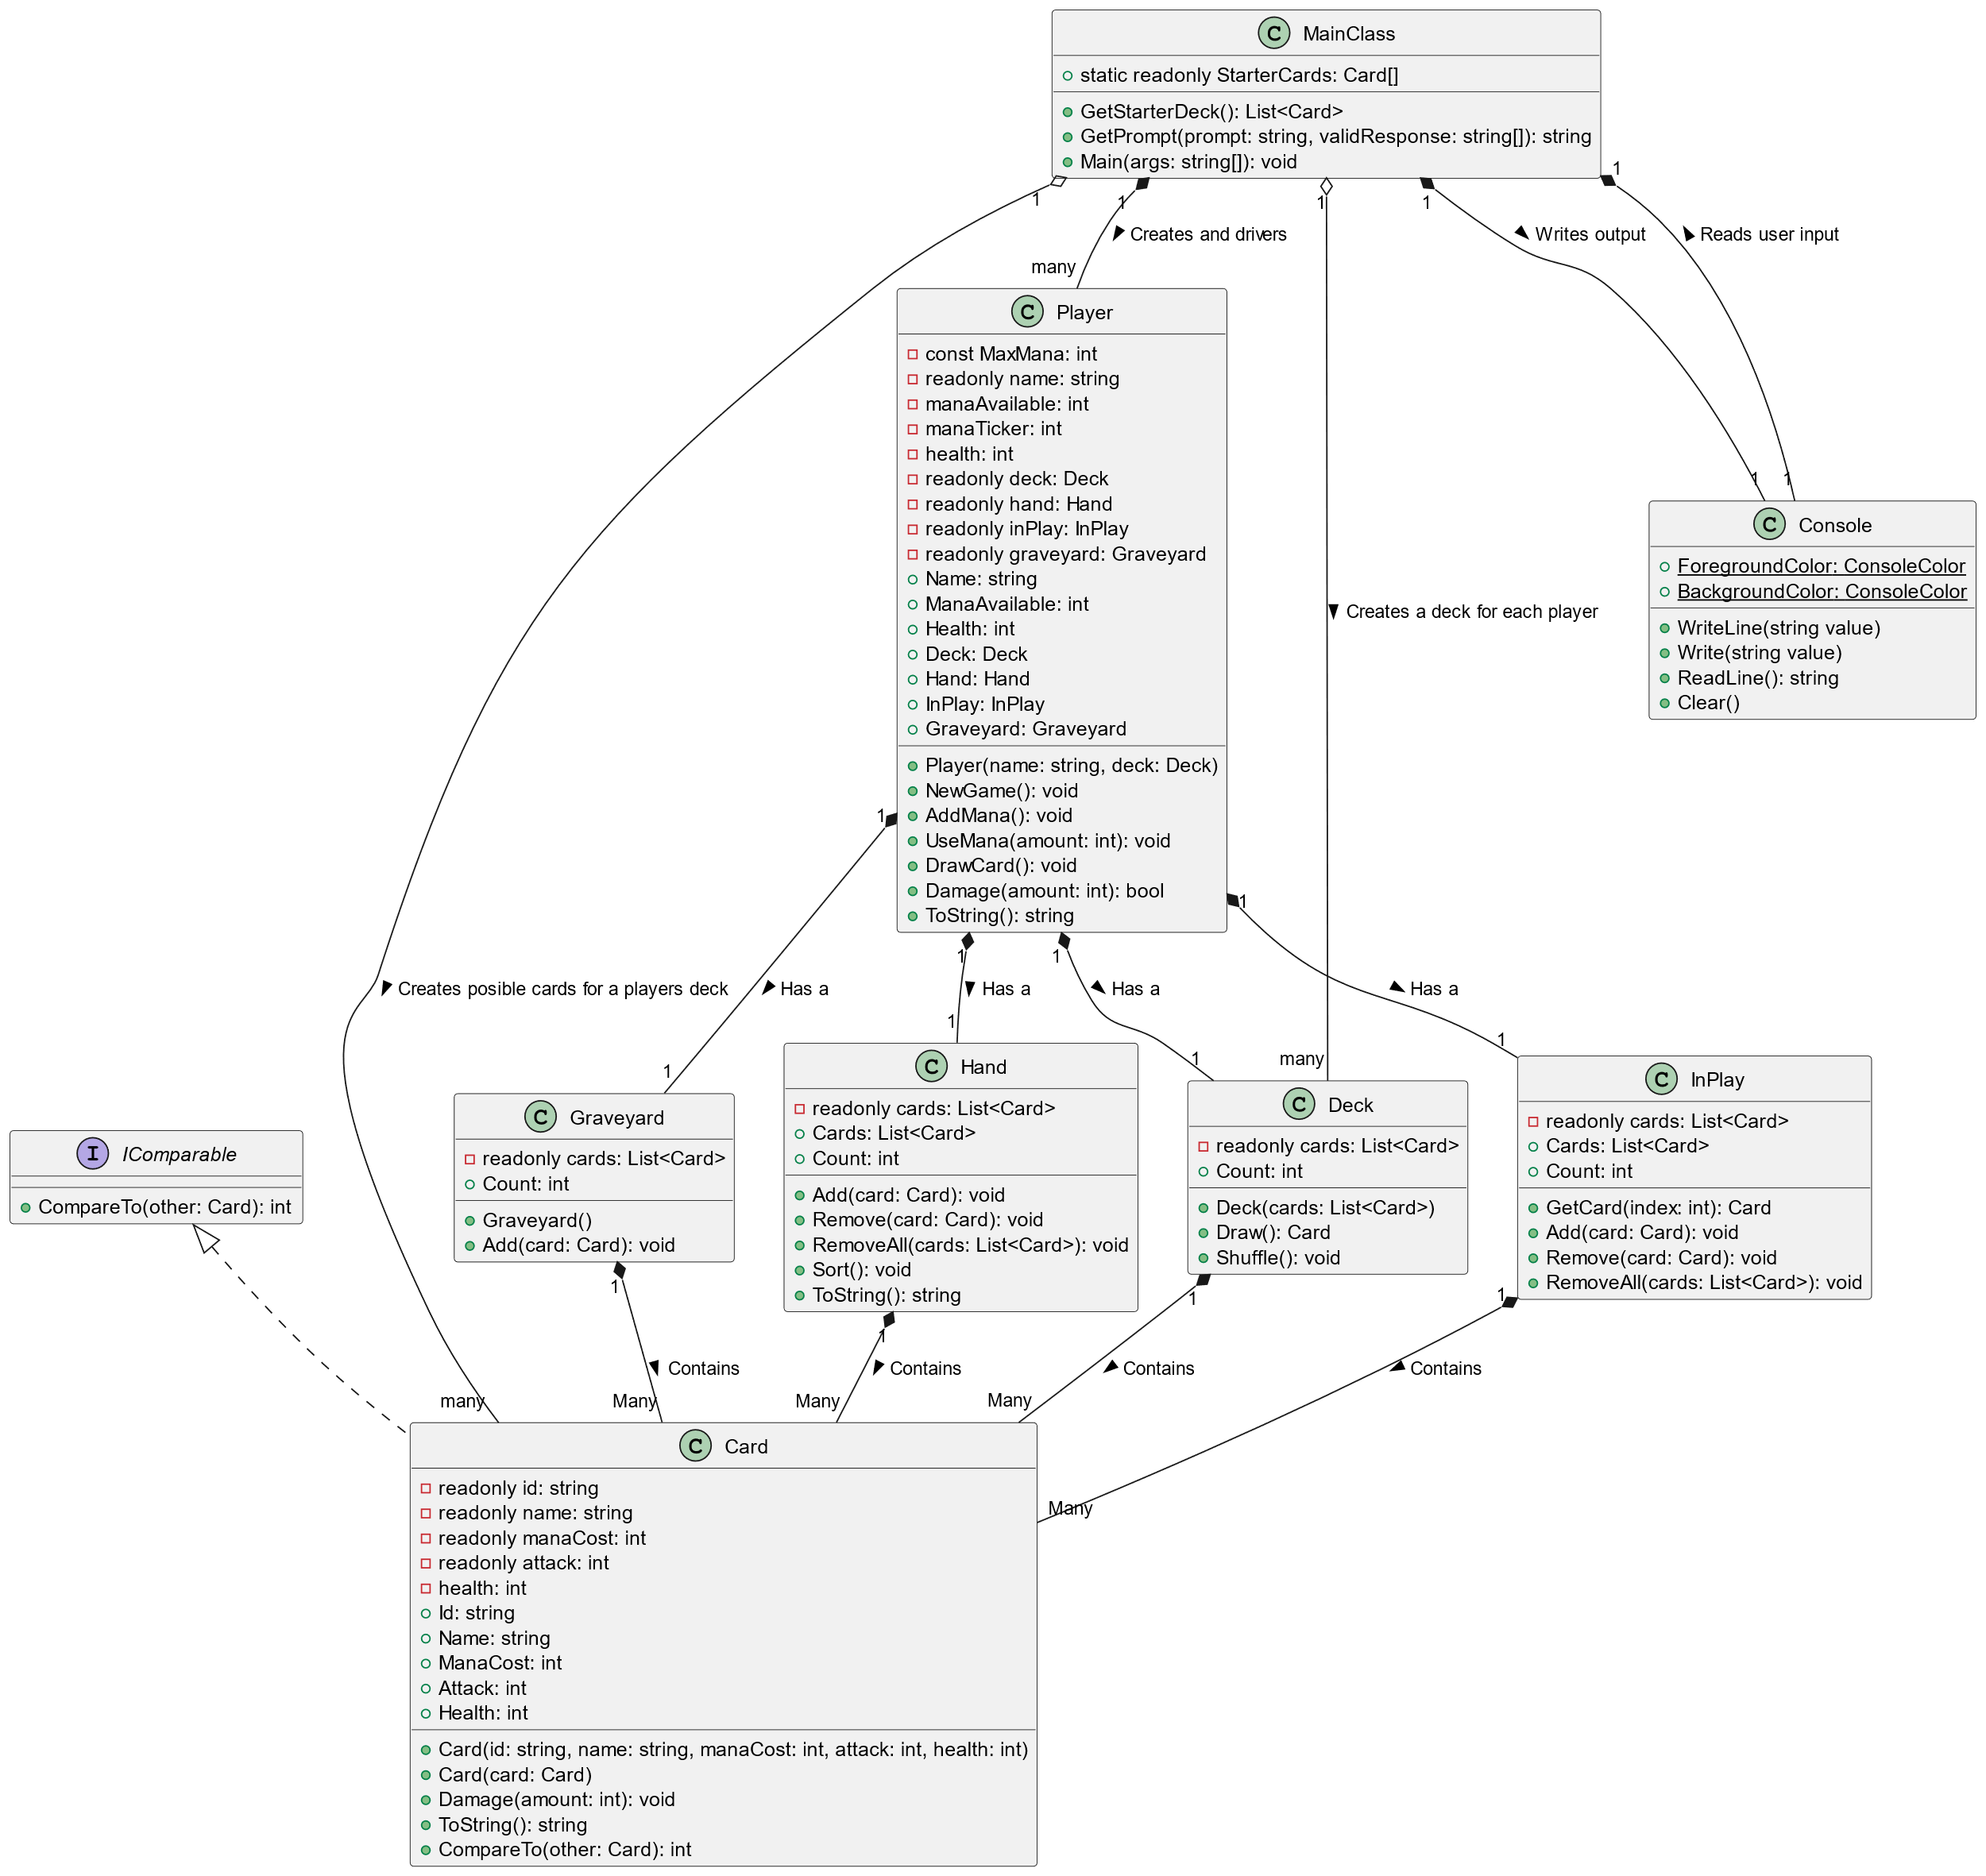
Aims of presentation
Identify And Discuss
Design Weaknesses
Implementations weaknesses
Proposed Improvement
Object orientated design principles
Appropriate use of abstract classes and interfaces
Proposed “PocketBeast” Cards Design
Decorator? Façade? Strategy? (Patterns)

Slide 3
Current Design: Let’s have a looks at what’s not the best

Slide 4
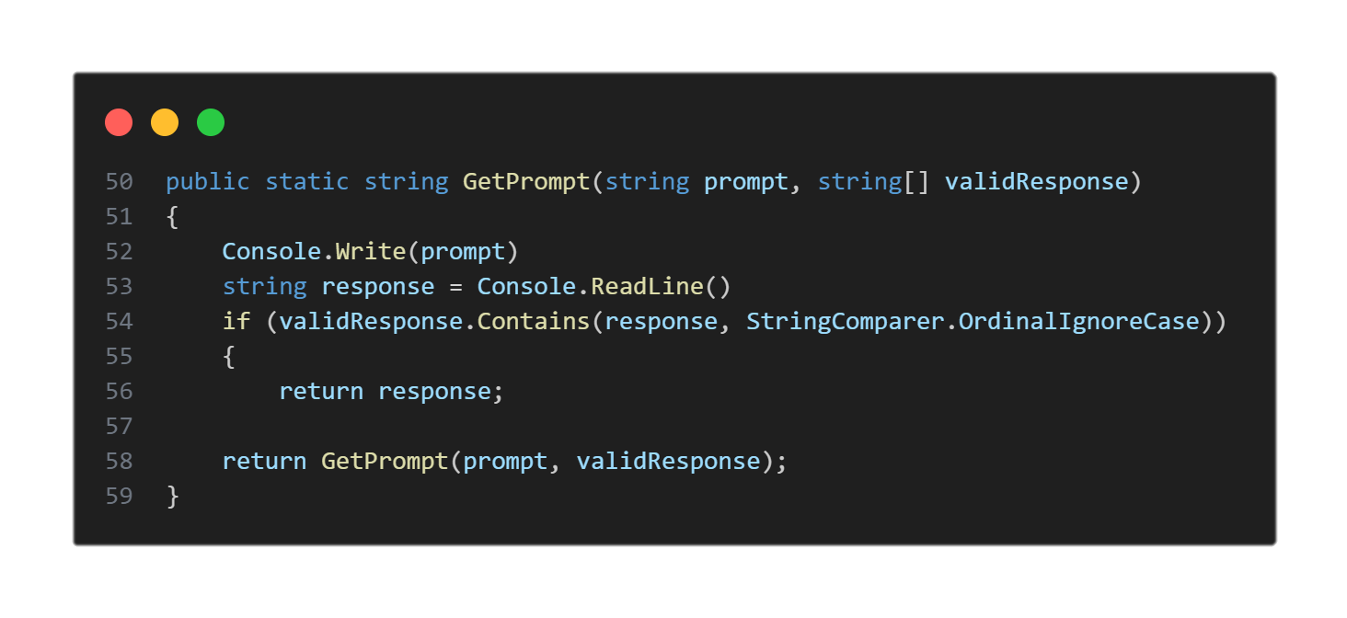
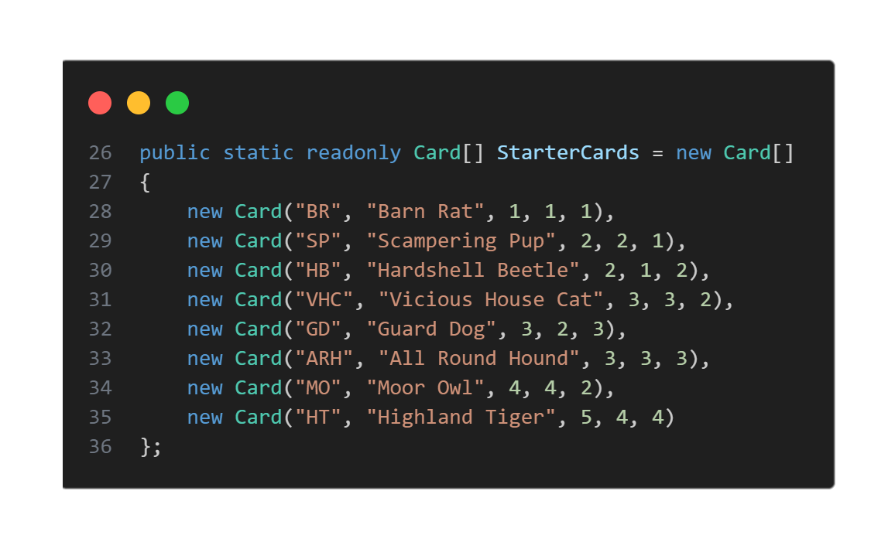
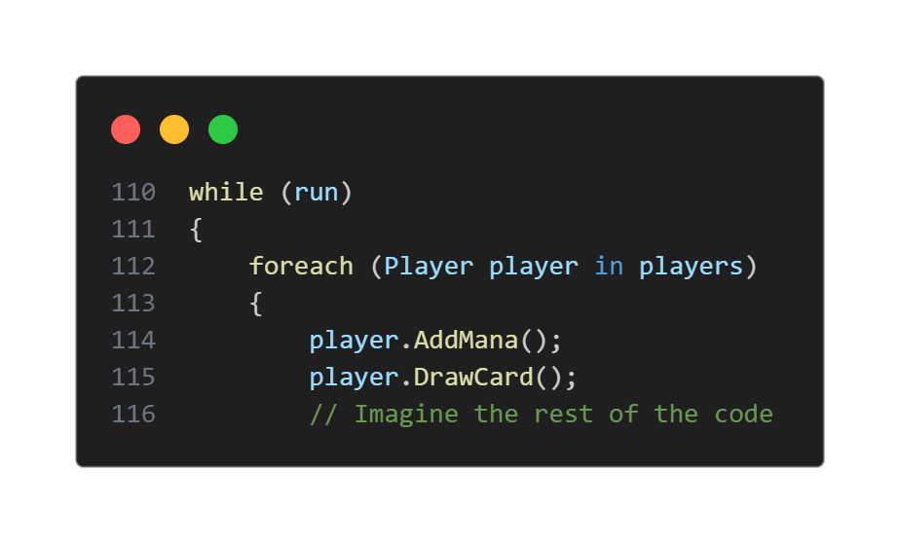
MainClass Too much responsibility! - Display game - User Interaction - Game Logic - Players - Decks

Slide 5
MainClass Too much responsibility! - Display game - User Interaction - Game Logic - Players - Decks
User Interface
Game Logic
Hard Coded Game Decks

Slide 6
Player: Player know too much about the game. Not all games will have the same attributes for the players

Slide 7
Card Containers: Lack of Abstraction Many class having duplicated methods Violates D.R.Y (Don’t Repeat Yourself) principles

Slide 8
Card Class Card class isn’t the worst However, this assumes all cards work the same and there isn’t a mechanism to modify any card behaviors.

